Slide 1
Data scientists' earnings and job satisfaction
Data Manipulation Group Assignment
Group members:
Xuehao Xiang
Huda Tanveer Siddiqui
Faruk Furkan KOC

Slide 2
Contents:
1. Introduction to the dataset
2. Research questions
1) How does working experience affect salary?
2) Is there correlation between Salary & Job Satisfaction by Geography?
3) Does Education level affect the salary or depends on other parameters?
4) What are the job satisfaction status in terms of level of education?
5) What percentage of data scientist or machine learning specialist code for hobby?

Slide 3
1. Introduction to the dataset

Slide 4
1. Introduction to the dataset
Why we chose this dataset?
We are going to become a data scientist (or analyst).
As a future data scientist, we all wanted to know what aspects could impact our future job’s salary and job satisfaction.

Slide 5
1. Introduction to the dataset
Our data is gathered from stackoverflow questionnaire
More than 33k records
14 different fields

Slide 6
1. Introduction to the dataset
fields we are most interested in:
Country of residence
Annual salary in US Dollars
Job satisfaction
Education level
Years of coding experience
Organization size
Code as hobby?

Slide 7
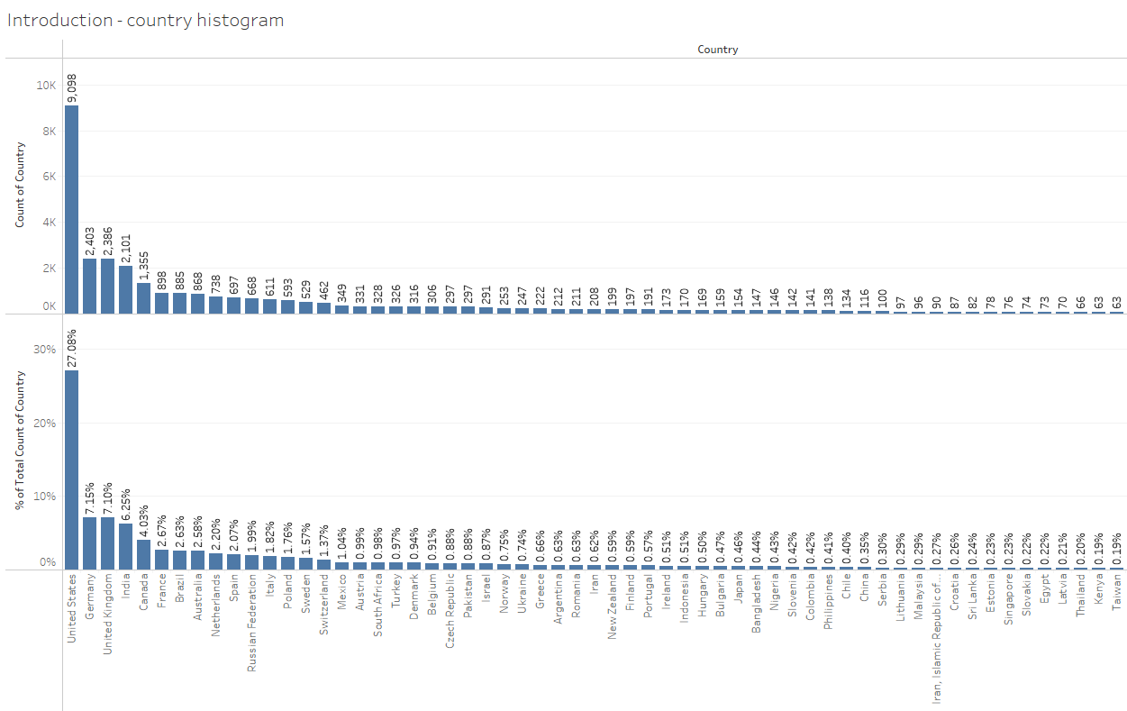
1. Introduction to the dataset
Country of residence

Slide 8
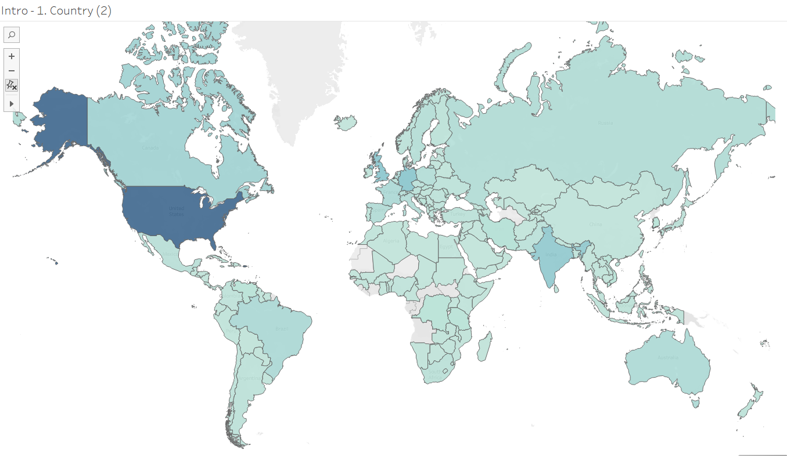
1. Introduction to the dataset
Country of residence

Slide 9
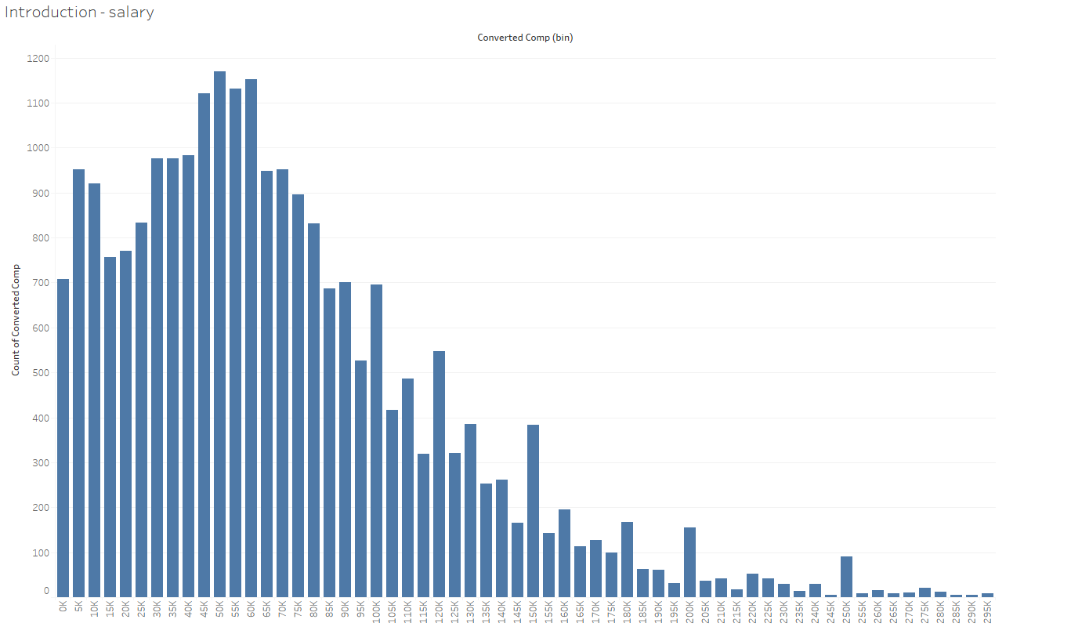
1. Introduction to the dataset
Annual salary in US Dollars

Slide 10
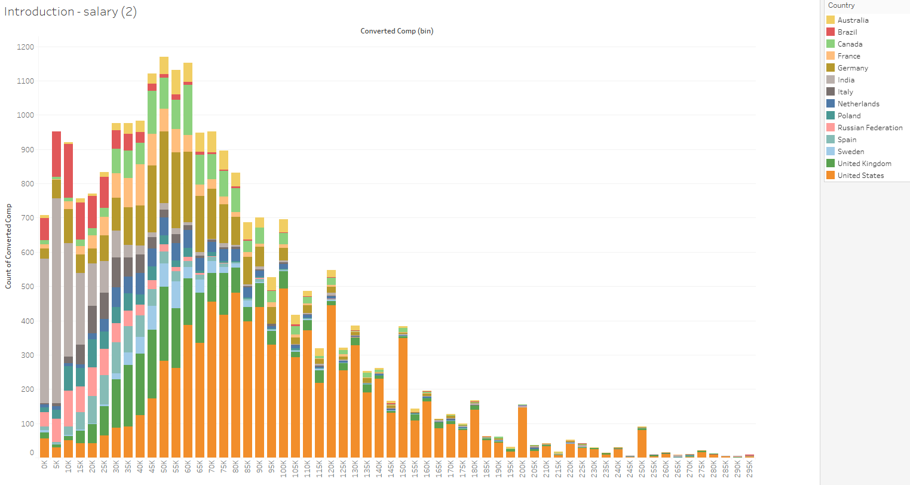
1. Introduction to the dataset
Annual salary in US Dollars

Slide 11
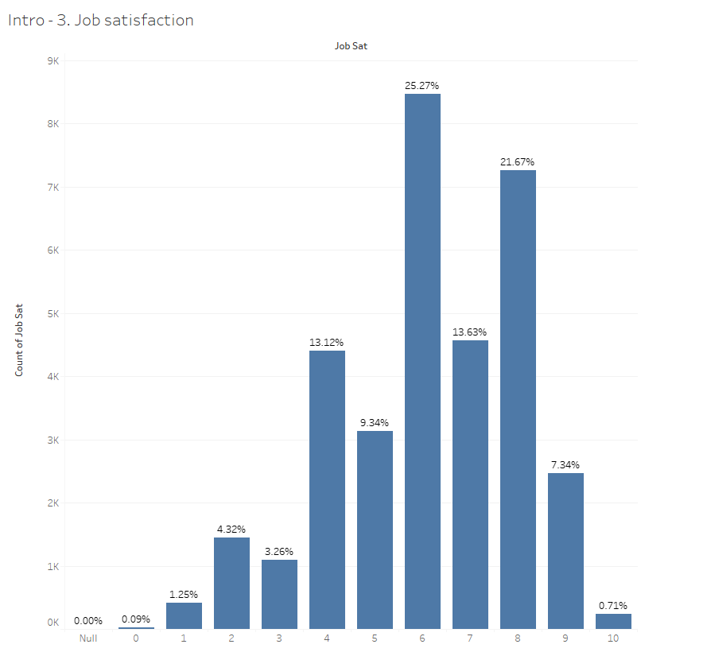
1. Introduction to the dataset
Job satisfaction

Slide 12
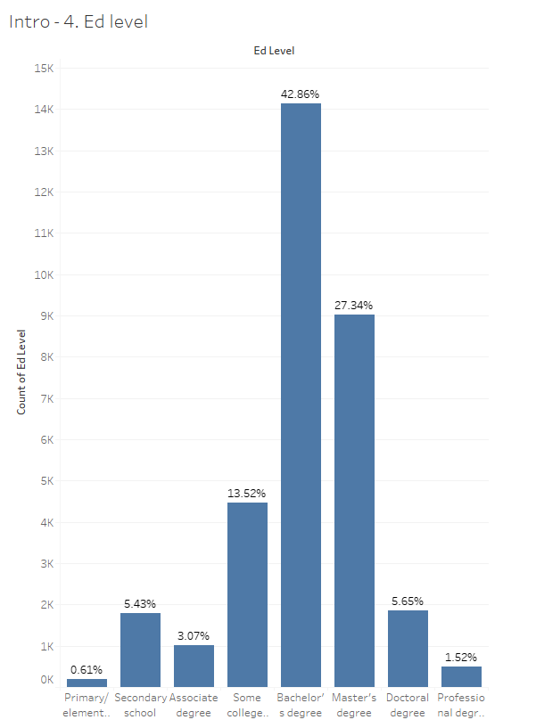
1. Introduction to the dataset
Education level

Slide 13
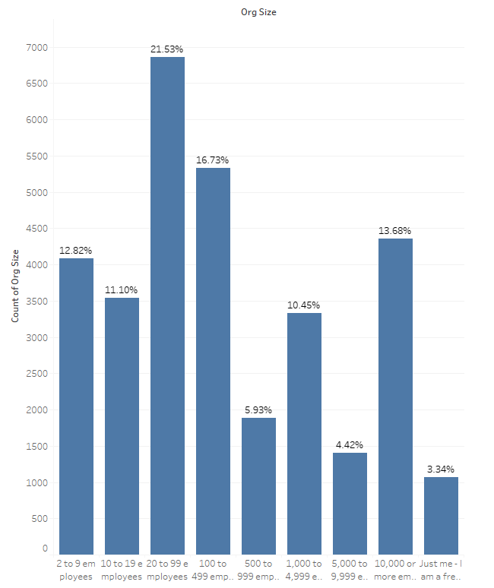
1. Introduction to the dataset
Organization size

Slide 14
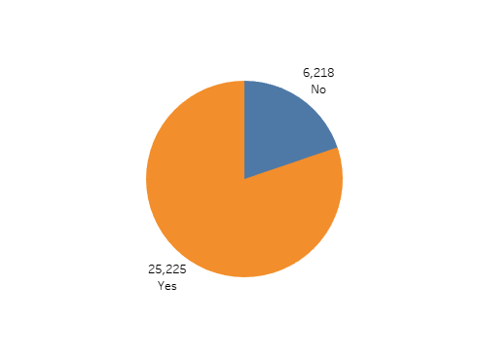
1. Introduction to the dataset
Code as hobby?

Slide 15
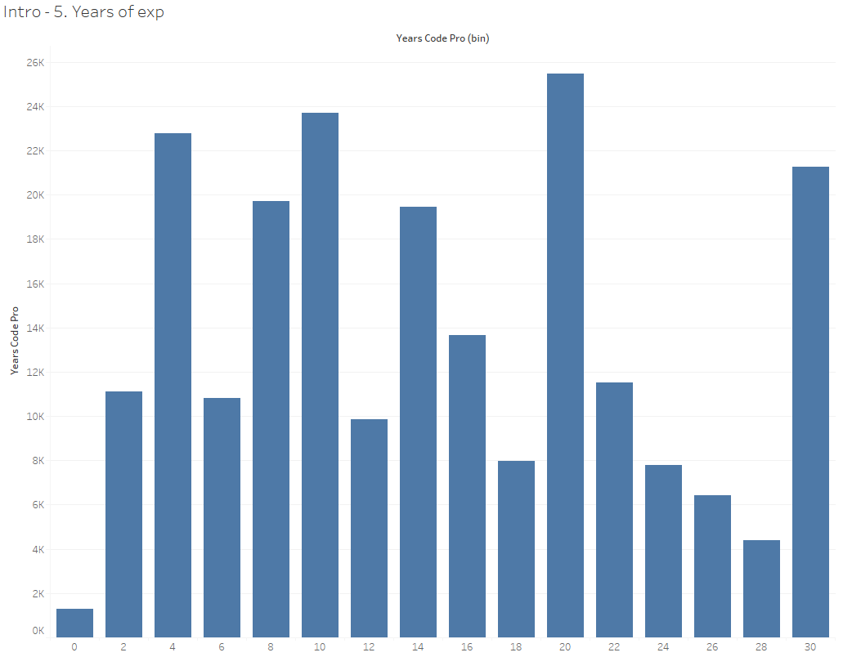
1. Introduction to the dataset
Years of coding experience

Slide 16
2. Research questions

Slide 17
2. Research questions
How does working experience affect salary?
Is there correlation between Salary & Job Satisfaction by Geography?
Does Education level affect the salary or depends on other parameters?
What are the job satisfaction status in terms of level of education?
What percentage of data scientist or machine learning specialist code for hobby?

Slide 18
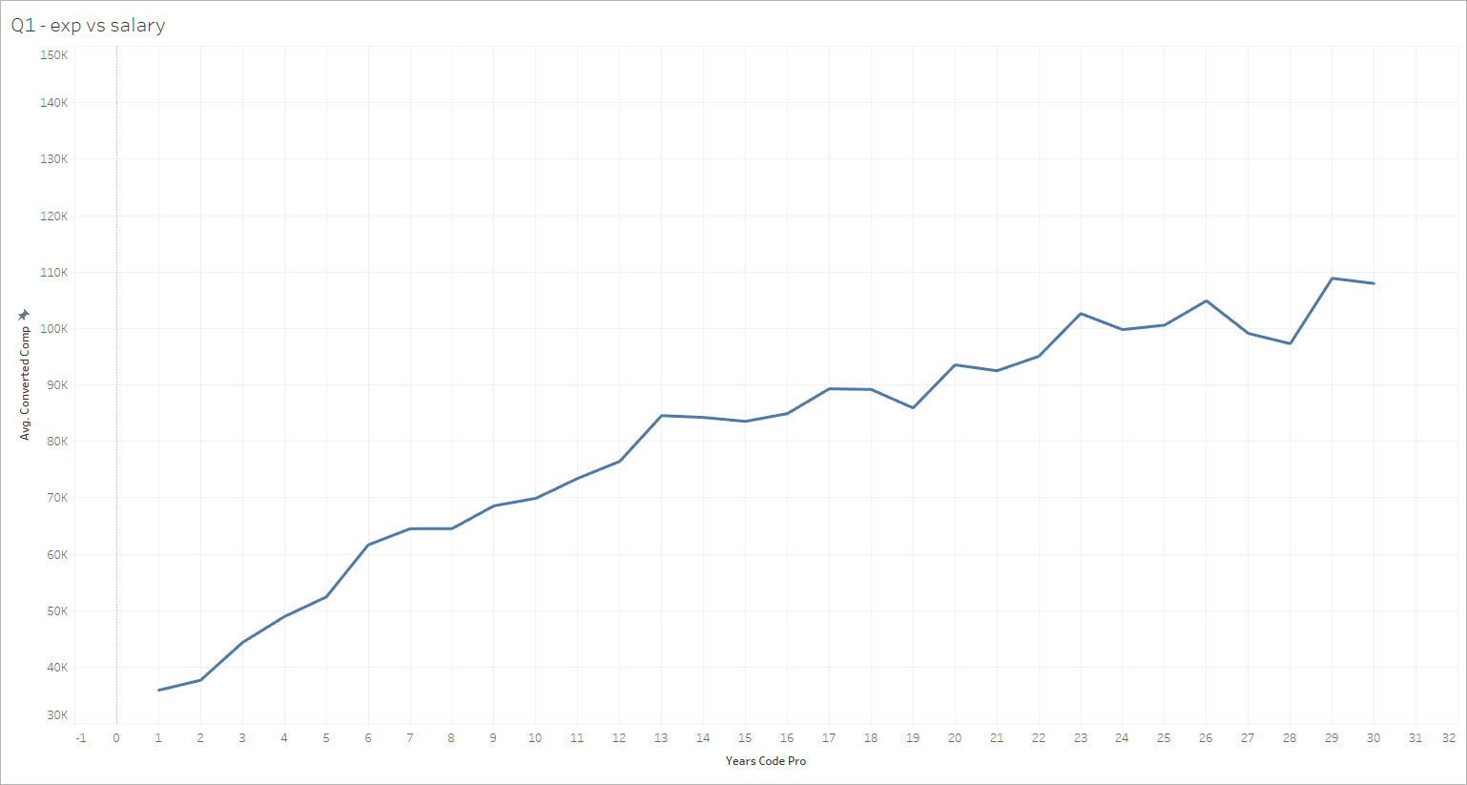
Q1. How does working experience affect salary?

Slide 19
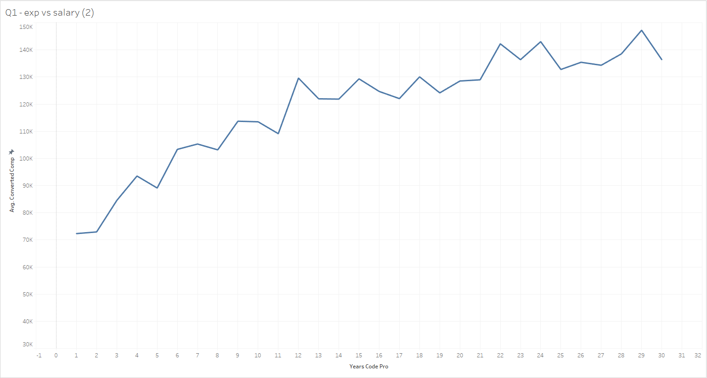
Q1. Is salary positively correlated with working experience?

Slide 20
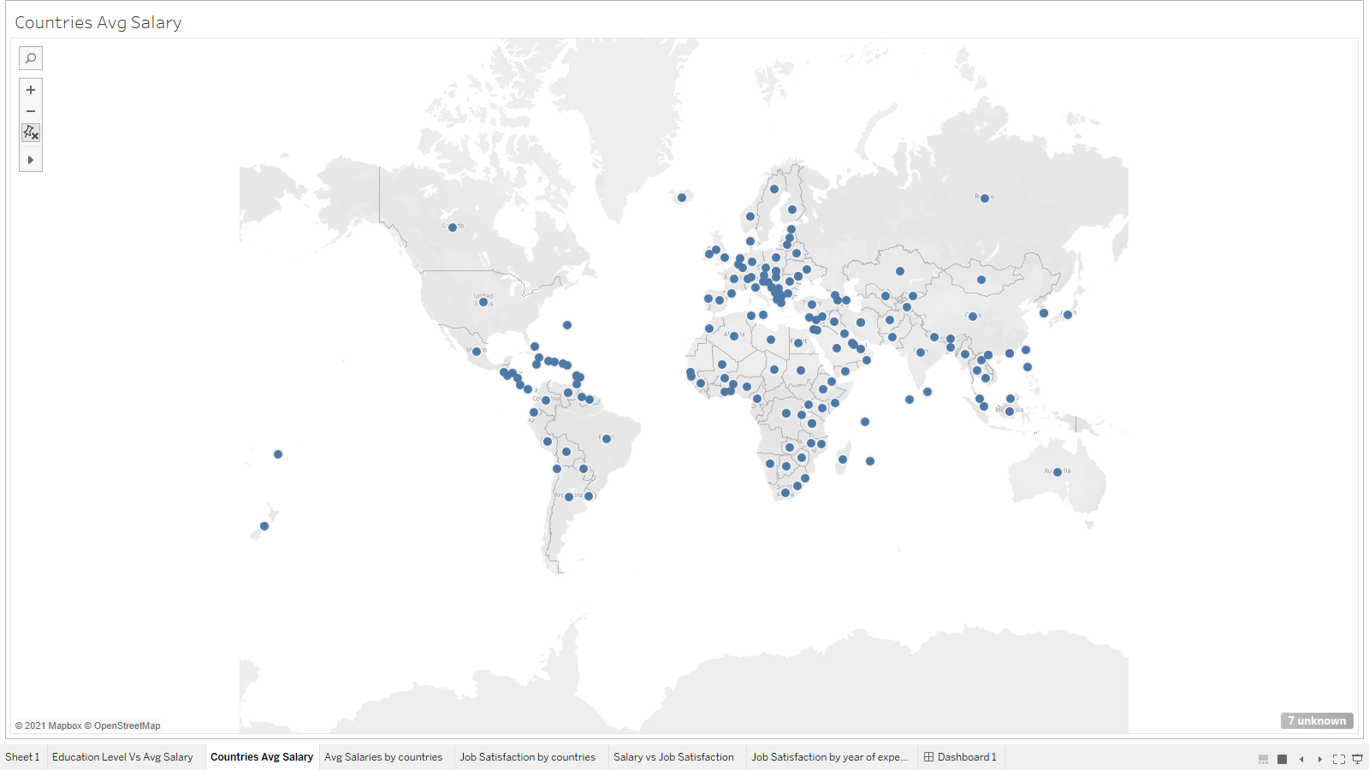
What is the geographical distribution of Data Scientist?
US being the top country to have most Data Scientist.
Chile being the country to have least Data Scientist.

Slide 21
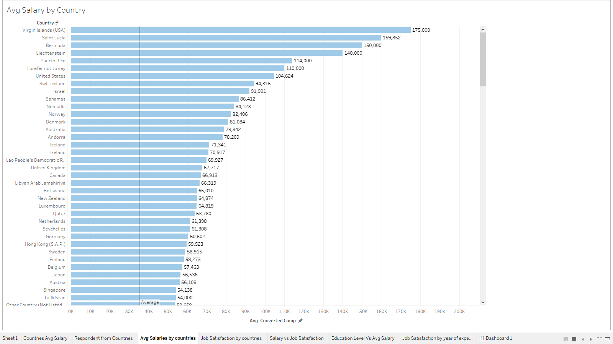
Does the geographical distribution affect Data Scientist Salary?

Slide 22
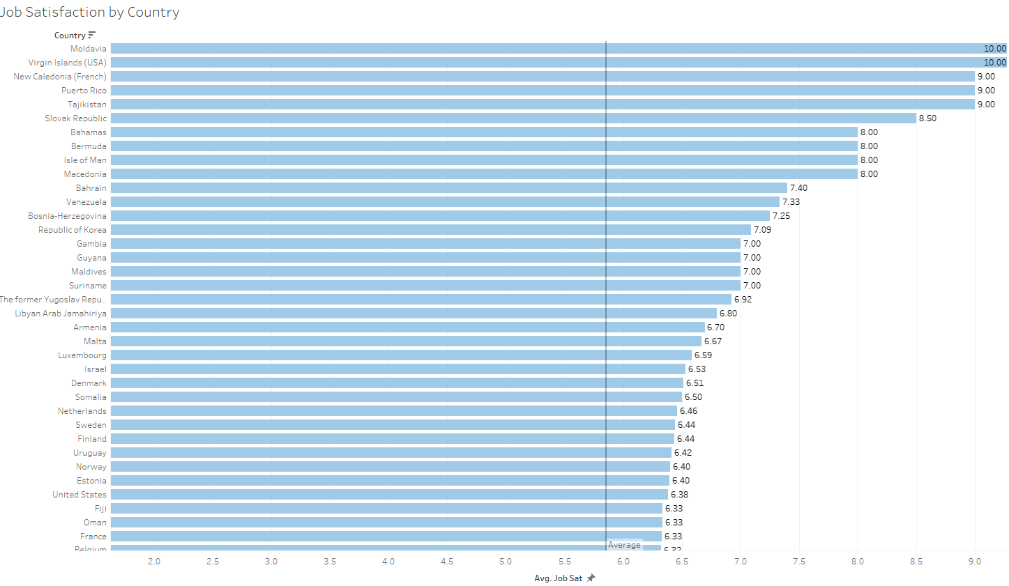
Does this geographical distribution affect Job Satisfaction?

Slide 23
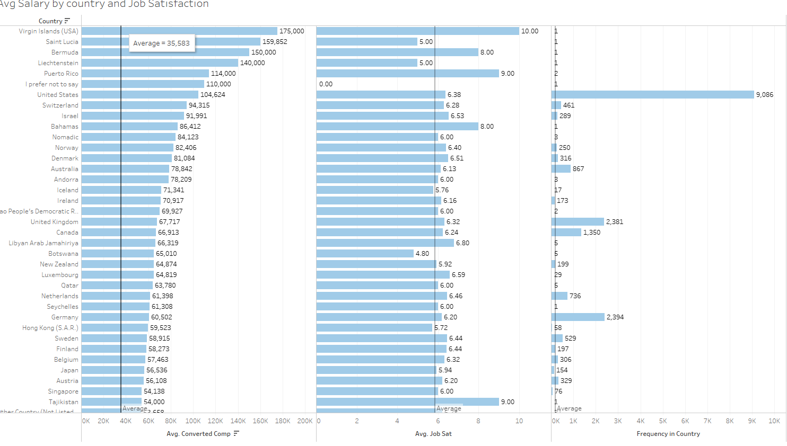
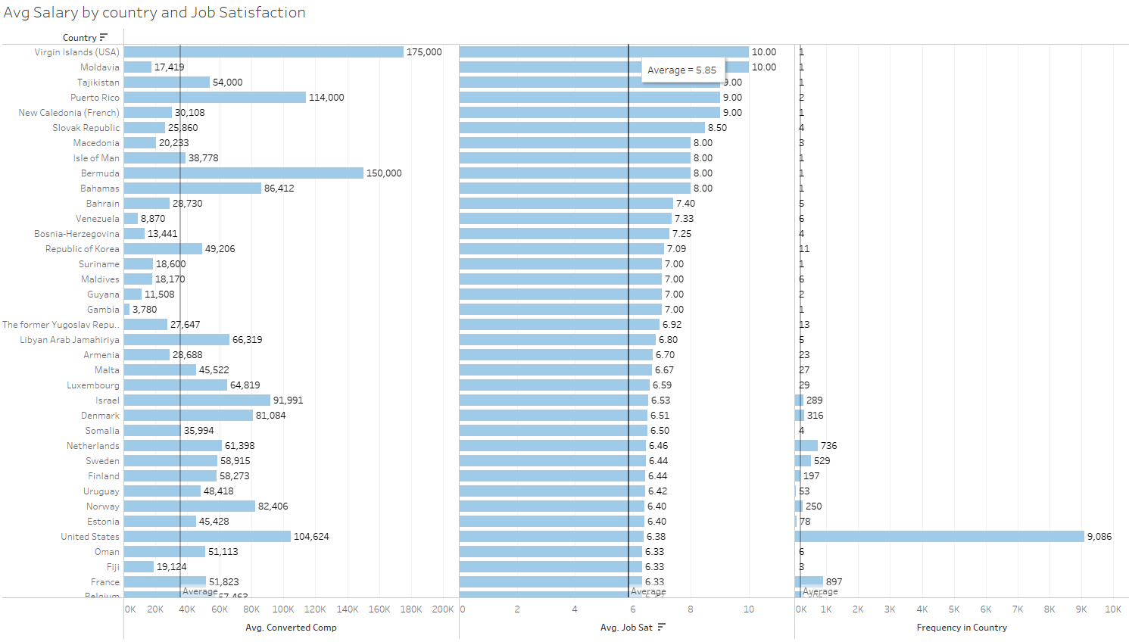
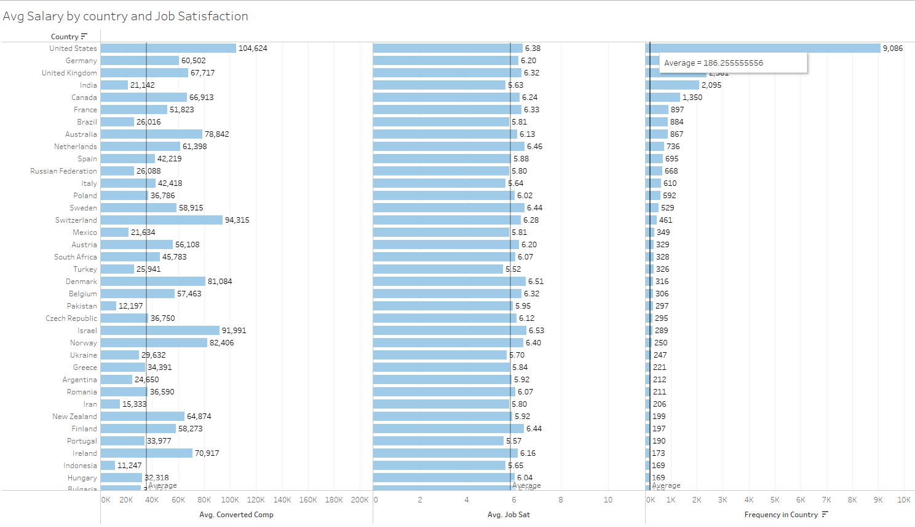
Is there correlation between Salary & Job Satisfaction by Geography?

Slide 24
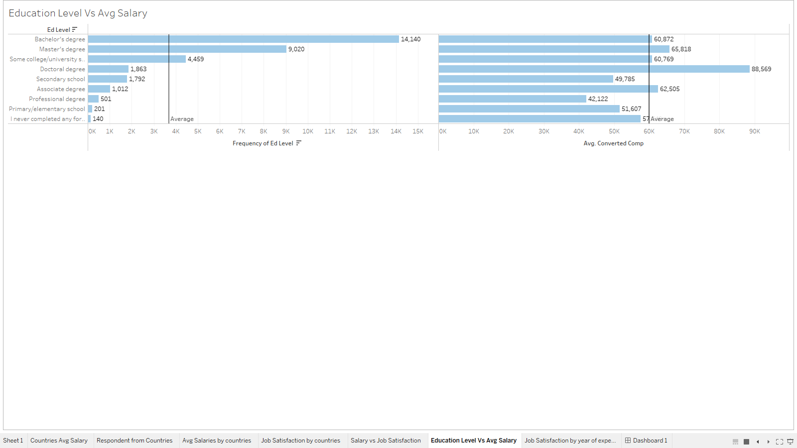
Does Education level affect the salary or depends on other parameters?

Slide 25
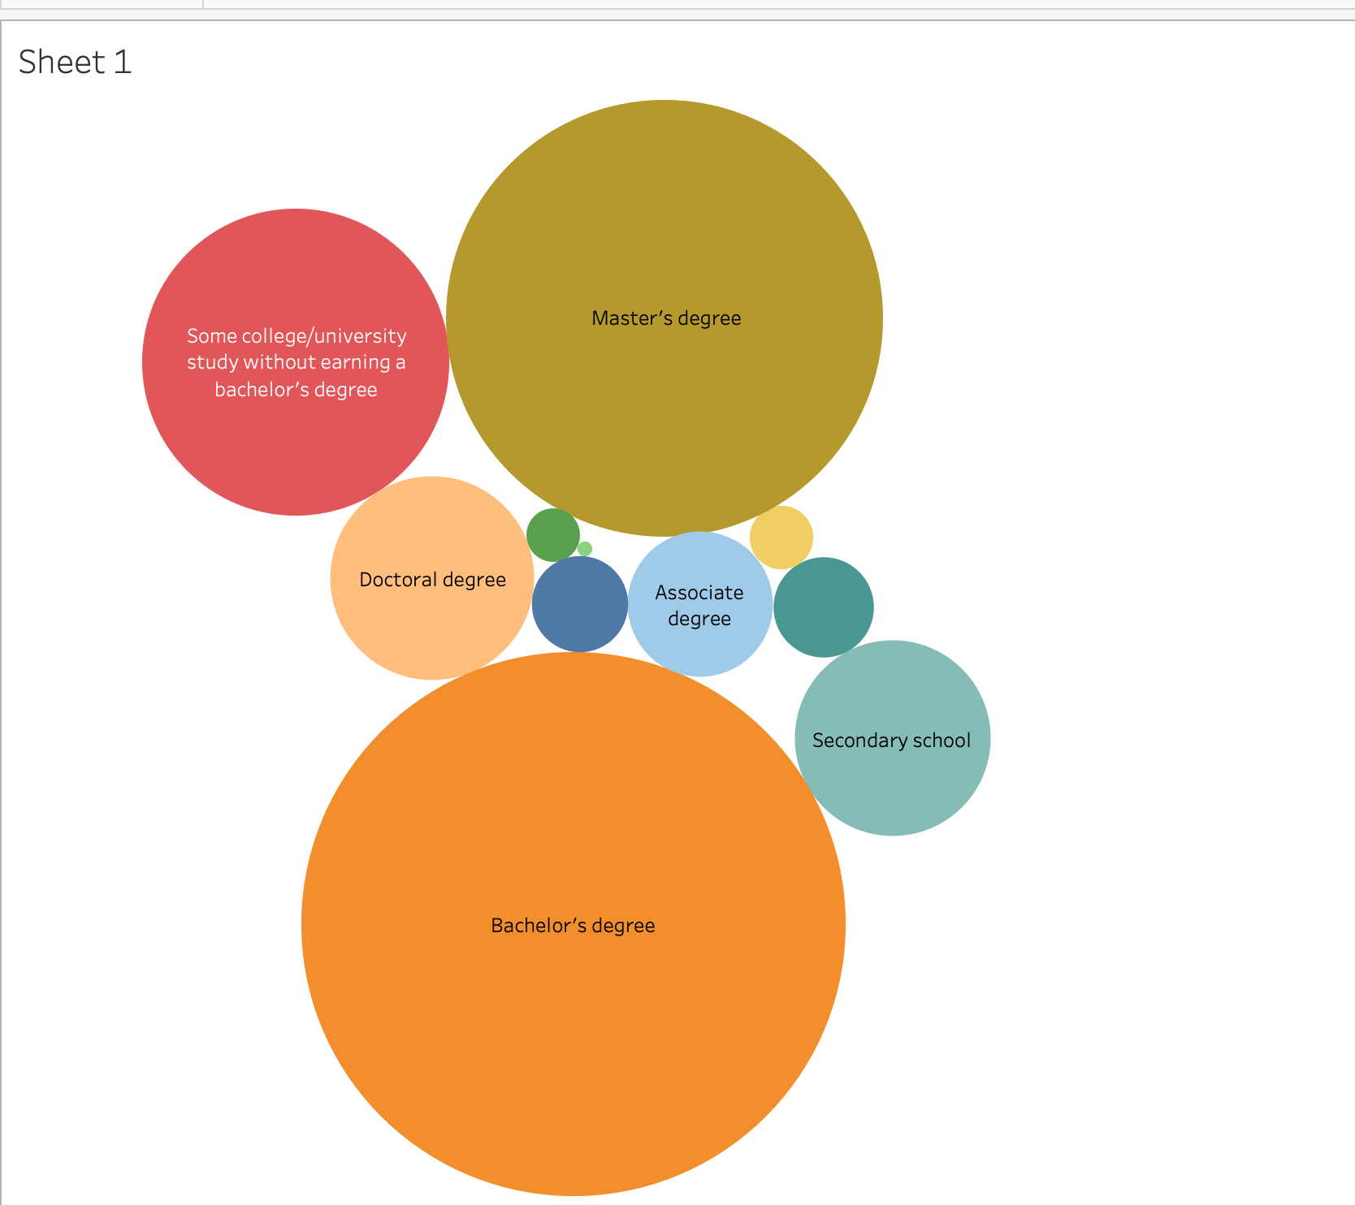
What are the job satisfaction status in terms of level of education?

Slide 26
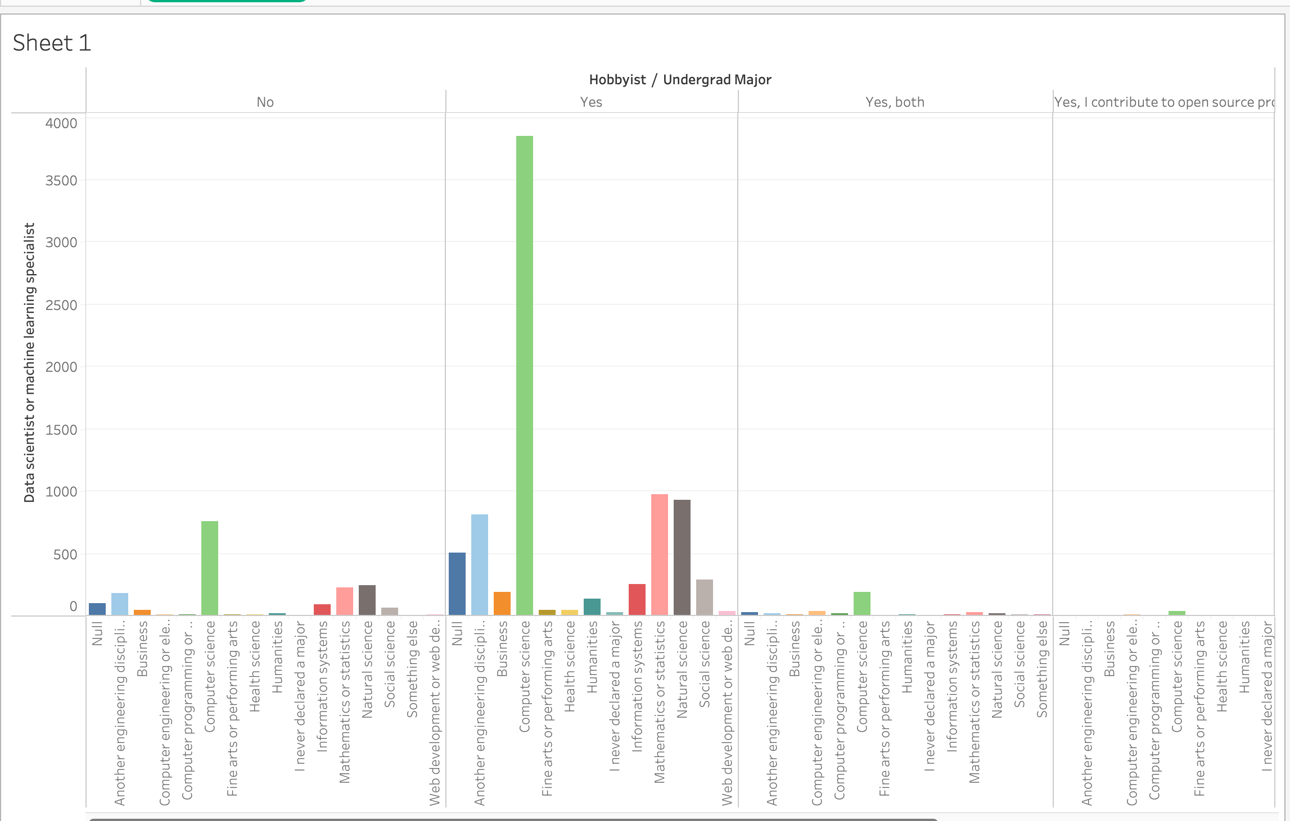
What percentage of of data scientist or machine learning specialist code for hobby?

Slide 27
Thank You

